Slide 1
FNDB020 Lecture 10
Accounting for Inventories Part II

Slide 2
Learning Objectives
Specific Inventory Valuation
FIFO
LIFO
Moving/Weighted average

Slide 3
Inventory
Are goods or property purchased and held for sale, as part of regular business activities.
Stock and stock in trade are common alternative account names for inventory.
Inventory is classified as a current asset on the balance sheet as it is expected to be sold within 12 months.

Slide 4
How is the cost of inventory allocated?
Inventory cost is allocated between the inventory on hand (inventory not yet sold), and the inventory sold to customers.
Inventory on hand at the end of the accounting period is a current asset (Inventory).
It is reported on the Balance sheet.
Inventory sold during the accounting period
Is recorded as cost of goods sold (COGS) = expense and is reported on the Income statement

Slide 5
Accounting for inventory Two methods
Perpetual inventory
Suitable for inventory of high unit value
Needs sophisticated computer system
Periodic inventory
Suitable for inventory with low value and large quantities

Slide 6
Accounting for Inventories Periodic Inventory System
When a periodic inventory system is used, the the Inventory account represents the cost of the inventory on hand at the beginning of the period. To determine the cost of the ending inventory, the units on hand at the end of the period must be counted and costed. The cost of ending inventory is then reported usually as a current asset in the balance sheet and is also deducted from the cost of goods available for sale in the income statement to determine the cost of sales

Slide 7
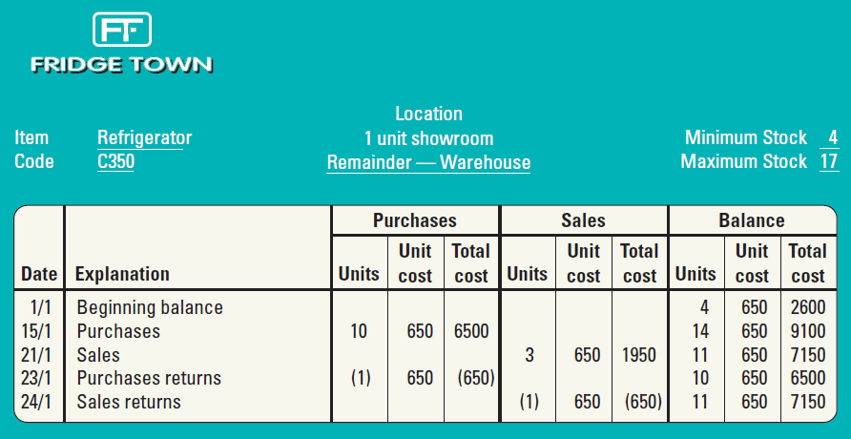
INVENTORY RECORD CARD

Slide 8
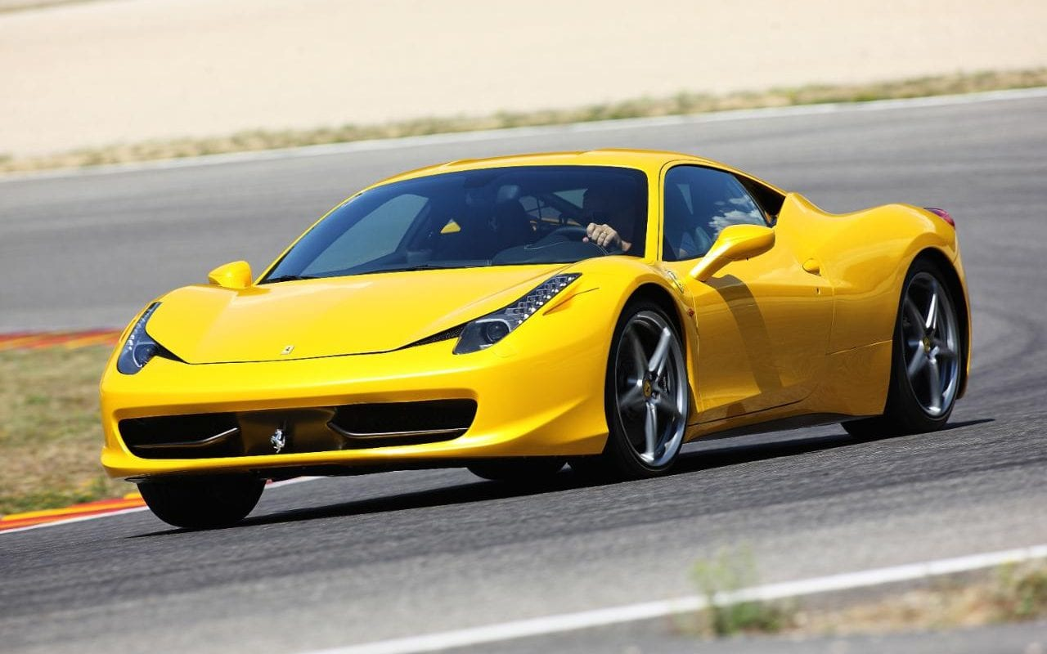
Identified Cost
The identified cost method requires each unit sold and each unit on hand to be identified with a specific purchase invoice.
the entity must use some form of identification such as serial numbers, stock tags, or bar codes containing the cost recorded in some appropriate coding system, which are attached to the item.

Slide 9
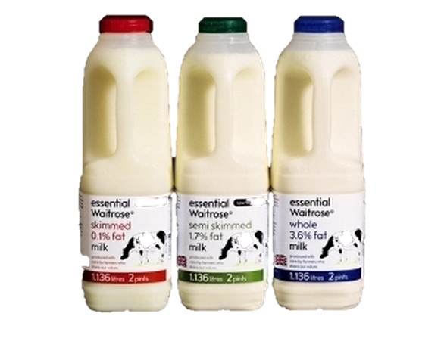
FIFO
The FIFO method of determining the cost of sales is based on the assumption that
the cost of the first units acquired is the cost of the first units sold.
Therefore, the cost of the units on hand is assumed to be the cost of the most recent purchases.

Slide 10
COMPARISON OF COSTING METHODS
Identified Cost
Consistent with the actual movement of the inventory
Offers room for manipulating profit
FIFO
Reflects current prices in ending inventory
Does not permit manipulation of profit

Slide 11
COMPARISON OF COSTING METHODS
Which method to select
Entity should choose based on a range of factors
Ideally specific identification
Consistency
Need to be consistent
Must use the same accounting methods and procedures from period to period

Slide 12
COSTING METHODS IN THE PERPETUAL INVENTORY SYSTEM
Inventory record maintained for each item of inventory
Inventory control account maintained in the general ledger
Inventory records collectively constitute the inventory subsidiary ledger
Provides continuous record of transactions

Slide 13
EXAMPLE – FIRST-IN, FIRST-OUT (FIFO) METHOD
Sandwich Toaster |  |  |  |  | Code B1800
 |  | Purchases |  |  | Cost of sales |  |  | Balance
Date | Explanation | Units | Cost | Total | Units | Cost | Total | Units | Cost | Total
1/7 | Beginning Bal. |  |  |  |  |  |  | 10 | 10.00 | 100.00
15/9 | Purchases | 12 | 11.00 | 132.00 |  |  |  | 10 | 10.00 | 100.00
 |  |  |  |  |  |  |  | 12 | 11.00 | 132.00
20/9 | Sales |  |  |  | 8 | 10.00 | 80.00 | 2 | 10.00 | 20.00
 |  |  |  |  |  |  |  | 12 | 11.00 | 132.00
7/12 | Purchases | 15 | 12.00 | 180.00 |  |  |  | 2 | 10.00 | 20.00
 |  |  |  |  |  |  |  | 12 | 11.00 | 132.00
 |  |  |  |  |  |  |  | 15 | 12.00 | 180.00
12/1 | Sales |  |  |  | 2 | 10.00 | 20.00 | 4 | 11.00 | 44.00
 |  |  |  |  | 8 | 11.00 | 88.00 | 15 | 12.00 | 180.00
 |  |  |  |  |  |  |  |  |  | 224.00

Slide 14
The following information relates to the inventory of Gadgets Ltd during May:
Gadgets Ltd uses a perpetual inventory system. Ignore GST.
May 1 3 10 12 17 25 | Beginning Inventory Purchased Purchased Sold Sold Sold | 80 90 110 90 80 30 | units units units units units units | @ $7 @ $8 @ $9
Required
Determine the cost of the ending inventory (assuming there have been no stock losses) and the cost of sales, using FIFO method

Slide 15
Stock card
 |  | Purchases |  |  | Sales |  |  | Balance
Date | Explanation | Units | Unit Cost | Total Cost | Unit | Unit Cost | Total Cost | Units | Unit Cost | Total Cost
1/5 | Beg. Invent.
3/5
10/5
12/5
17/5
25/5

Slide 16
Tutorial
Multi Choice Questions
Task 1 Suppose Kmart buys $185 800 worth of MegoBlock toys on credit terms of 2/10, n/30. Some of the goods are damaged in shipment, so Kmart returns $18 530 of the goods to MegoBlock. All amounts are inclusive of GST.
Requirement How much must Kmart pay MegoBlock:
after the discount period?
within the discount period?
a. | Original purchase amount
 | Less: Purchase returns
 | Kmart pays this amount after the discount period
b. | Kmart pays this amount within the discount period (-2%)

Slide 17
Task 2
Suppose a Myers store purchases $61 000 of women’s sportswear on credit from Tomas on 1 July 2016. Credit terms are 2/10, net 45. Myers pays electronically and Tomas receives the money on 10 July 2016.
Requirements
What was Myers’ net cost of this inventory? Ignore GST.
Journalize Myers’ transactions for 1 July 2016 and 10 July 2016. should use special journals.

